Slide 1
Workshop “Must Haves”
Internet
Pre-Post Test
Chart paper or regular paper & sticky notes for Writing Task Activity (shoes)
Handout: Writing Guidance for Scope & Sequence Development for Writing Task Activity (shoes)
Other Materials You May Need for this Session:
Printed PowerPoint
Writing Standards
Writing Glossary
Text Structure Handout
“App”etizers Handout
Strategy Handouts
Optional Idea
Best Practice Document from Writing Matters homepage – possible jigsaw activity.
Notes:
The items in the “must haves” are necessary for the workshop. The one handout listed here is a “must have” because of the details we want all participants to learn about the writing tasks expected at their grade level.
The optional idea listed on this slide is for presenters who feel their audience would benefit from reading writing research about writing best practices. The documents you can choose from are on the ilwritingmatters webite homepage.

Slide 2
Sentence Patterns
Writing Matters
June 22
Foundation Services Presentation
Stephanie Rubach
srubach@steeleville138.org

Slide 3
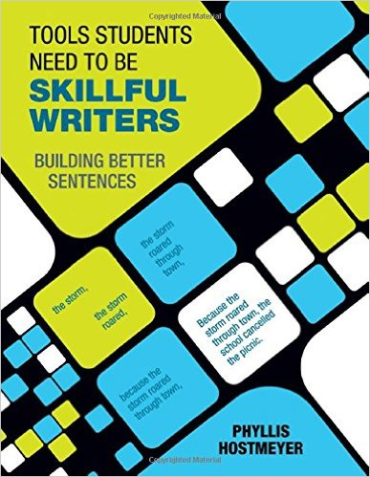
Today’s Agenda
What do the NILs Writing Standards say about sentence structure?
Parts of Speech Activities
Sentence Patterns
Sentence Combining
Additional Activities
Writing Activities
Notes:
This is an outline of the agenda. The additional components can be deleted based on the presenters discretion.
Amazon, Barnes and Noble, and Corwin (publisher) $36.95

Slide 4
www.ilwritingmatters.org
NEW!!
Notes:
The ISBE ELA Content Specialists have developed the Writing Matters website.
The philosophy behind this website creation was to assist educators in finding resources and strategies for implementing the new Illinois writing standards. The site should be the first thing participants should go through if they are attending a session. If possible, participants could be asked to go through the site prior to the training. If not, plan 30 minutes to go through the site together.

Slide 5
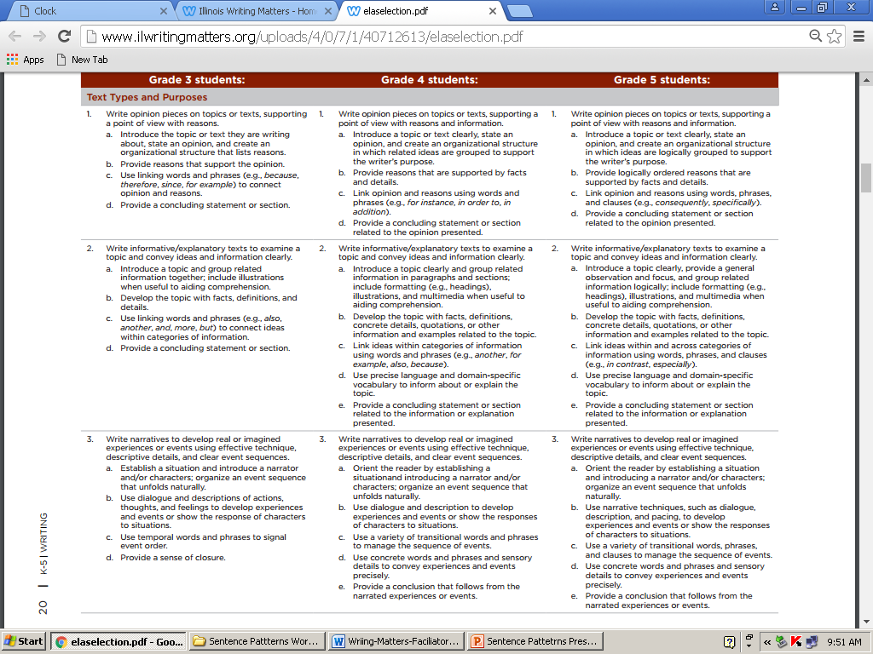
Taken from Writing Standards

Slide 6
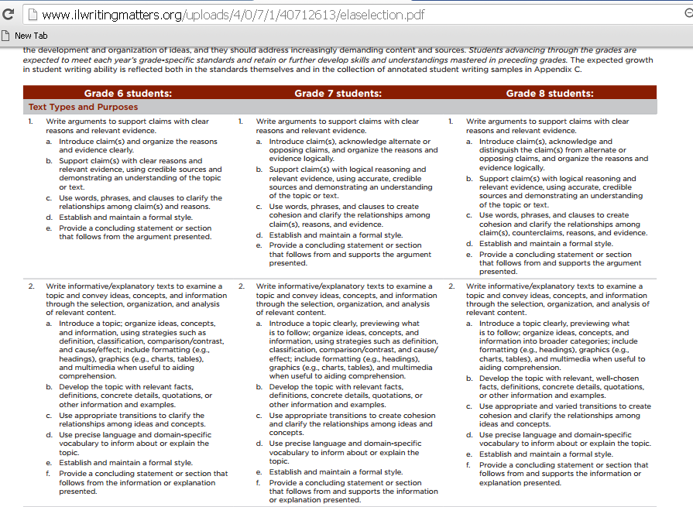
Taken from Writing Standards

Slide 7
Taken from What Works: Teaching Elementary Students to be Effective Writers

Slide 8
Taken from What Works: Teaching Elementary Students to be Effective Writers

Slide 9
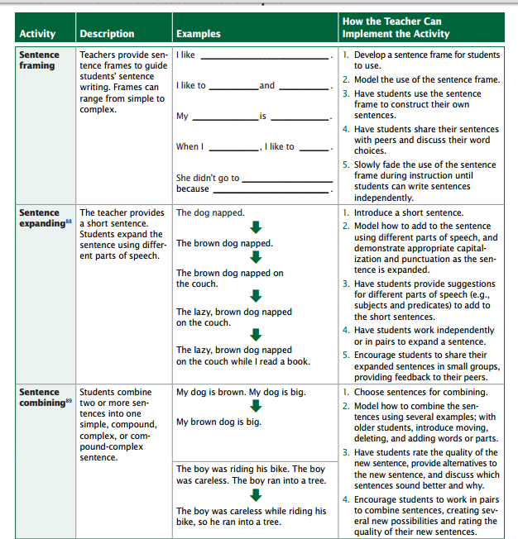
Taken from What Works: Teaching Elementary Students to be Effective Writers

Slide 10
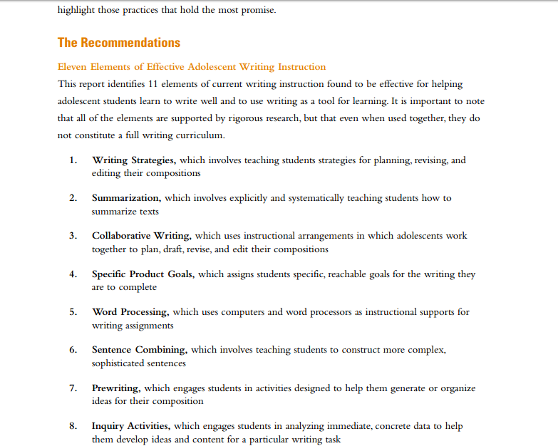
Taken from Writing Next: Effective Strategies to Improve Writing of Adolescents in Middle and High School

Slide 11
The Writing Standards
.
3 Types of Writing
Standards 4-6
Standards 7-9
Standard #10
Standard #10
Notes:
The graphic on this slide is an attempt to show how all 10 writing standards play into one another. We will look at them today as well as the role we play as teachers to teach the New Illinois Writing Standards.

Slide 12
TEACHER RESPONSIBILITY
“I do it”
Focus Lesson
Guided Instruction
“We do it”
“You do it
together”
Collaborative
Independent
“You do it
alone”
STUDENT RESPONSIBILITY
A Model for Success for All Students
Fisher, D., & Frey, N. (2008). Better learning through structured teaching: A framework for the gradual release of responsibility. Alexandria, VA: Association for Supervision and Curriculum Development.
Notes:
At first we need to remind ourselves how students learn. A model for success for our students comes from Fisher and Frey.
Teaching and learning anything requires a reminder on how students learn. The Gradual Release of Responsibility model show us the 4 components necessary for success in learning.

Slide 13
The sudden release of responsibility
TEACHER RESPONSIBILITY
“I do it”
Focus Lesson
“You do it
alone”
Independent
STUDENT RESPONSIBILITY
Fisher, D., & Frey, N. (2008). Better learning through structured teaching: A framework for the gradual release of responsibility. Alexandria, VA: Association for Supervision and Curriculum Development.
Notes:
Fisher and Frey (with a humorous, but not absent in many classrooms twist) is the “Sudden Release of Responsibility”. This framework can seem successful but it is for students who learn quickly and on their own or for those who already can do the skill.

Slide 14
DIY School
TEACHER RESPONSIBILITY
(none)
“You do it
alone”
Independent
STUDENT RESPONSIBILITY
Fisher, D., & Frey, N. (2008). Better learning through structured teaching: A framework for the gradual
release of responsibility. Alexandria, VA: Association for Supervision and Curriculum Development.
Notes:
Hopefully this version of the Gradual Release of Responsibility is absent in classrooms – the “Do It Yourself” version.

Slide 15
TEACHER RESPONSIBILITY
Focus Lesson
“I do it”
Guided Instruction
“We do it”
“You do it
together”
Writing Next
#3
Collaborative
Independent
“You do it
alone”
STUDENT RESPONSIBILITY
A Model for Success for All Students
Fisher, D., & Frey, N. (2008). Better learning through structured teaching: A framework for the gradual release of responsibility. Alexandria, VA: Association for Supervision and Curriculum Development.
Notes:
The collaborative portion of this model is essential and an added piece that many classrooms need to focus on. Collaboration means practicing the skills somewhat with just the support of peers and releasing the support of the teacher. Independent practice means watching the students practice it still under the watch of the teacher prior to assigning a task completely on their own at home.
For example, we watched this in a restaurant work beautifully as a training model recently. 4 personnel from the restaurant were engaged in an activity for training. A waitress learned her craft by watching how to wait on a table modeled, then had someone instruct her as she assisted waiting on two others. Next, she waited on them herself while the couple gave her feedback and finally, she came back and completed the rest of the “waiting” on her own while being watched by the manager. He coached her and supported her the entire time while everyone was able to give feedback and she was able to ask questions. Huge investment of time but she was far more skilled than had she just been sent out and the worker couple had an opportunity to sample the food they would be serving in the future.
Have participants look at the structure of the GRR. Have them turn and talk about which area may need improving in their classrooms. Share out.

Slide 16
Taken from Writing Next: Effective Strategies to Improve Writing of Adolescents in Middle and High School

Slide 17
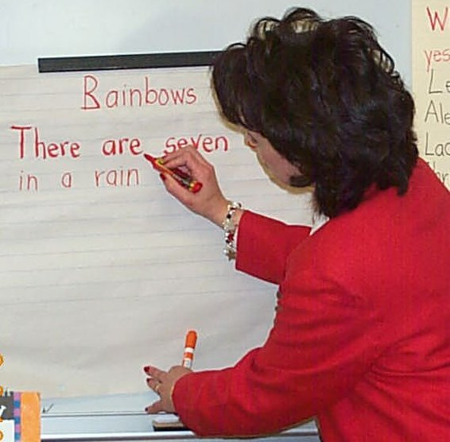
Shared Writing
Shared Writing will allow teachers to both model and actively engage students in the writing processes that they most need in order to improve their writing.
Teacher and students compose text together, with both contributing their thoughts and ideas to the process, while the teacher acts as scribe, writing the text as it is composed.
http://www.readwritethink.org/professional-development/strategy-guides/shared-writing-30686.html
http://www.regieroutman.org/files/6713/7842/4352/Tps_for_shared_writing.pdf
Notes:
For K-5 classrooms, students need a great deal of teacher modeling and guidance which is called for in the standards. Which part of the Model for Student Success chart is shared writing? Answer: We Do It
An additional handout “Must Know Tips for Shared Writing” from Regie Routman can be accessed here:
http://www.regieroutman.org/files/6713/7842/4352/Tps_for_shared_writing.pdf

Slide 18
Long before students begin writing they need to:
Identify necessary components of each pattern
Write examples and non-examples together as a class
Write examples together in small group
Notes:
Before many students can be successful as writers of different genres, writing teachers need to make sure that they (as well as the students), understand the language of the standards. Students need opportunities to watch their teachers model various components of the writing expected and to look at other texts written in the same genre. Teachers should provide students graphic organizers or frames to offer support for structure and as a tool for collecting notes.

Slide 19
Phyllis’ Website
http://www.phylsquill.com/educational-workshops.htm
Notes:
Her introduction to the Sentence Patterns

Slide 20
Pre-Sentence Pattern Teaching
Understanding of
Nouns
Verbs
Adjectives
Adverbs
Prepositions
Notes:
Her introduction to the Sentence Patterns

Slide 21
Nouns & Verbs
Build the foundation for the sentence patterns
Build vocabulary
Develop an eye for the weak word
Develop an ear for rhythm
Revise willingly
Notes:
Students need to not only know the definition of nouns and verbs and be able to recognize them (lowest levels on Bloom’s taxonomy), they need to be able to discuss and manipulate them in order to fully understand the first two, most basic patterns: noun-verb (S-V) and noun-verb-noun (S-V-DO). Once students have a good grasp on these two patterns, they will be able to more easily understand the following patterns.
The following activities are going to seem ridiculously easy, but they help build the foundations of the sentence patterns. Believe me, I have tied teaching the patterns with and without these activities; it is a MUCH easier process for the students if you use several of these activities, revisiting them throughout the year.

Slide 22
Noun Activities
Floodlight/Flashlight
Noun Town and Verb Suburb
Specific Noun Word Banks
The Lady Walked (Mundane Sentences)
Sentence Slam
Relay Race
Notes:
Do not try to use them all; choose the ones that you feel will make the best connections for your students. I use floodlight/flashlight, Specific Noun Word Banks, Mundane Sentences, and Sentence Slam (usually the favorite).

Slide 23
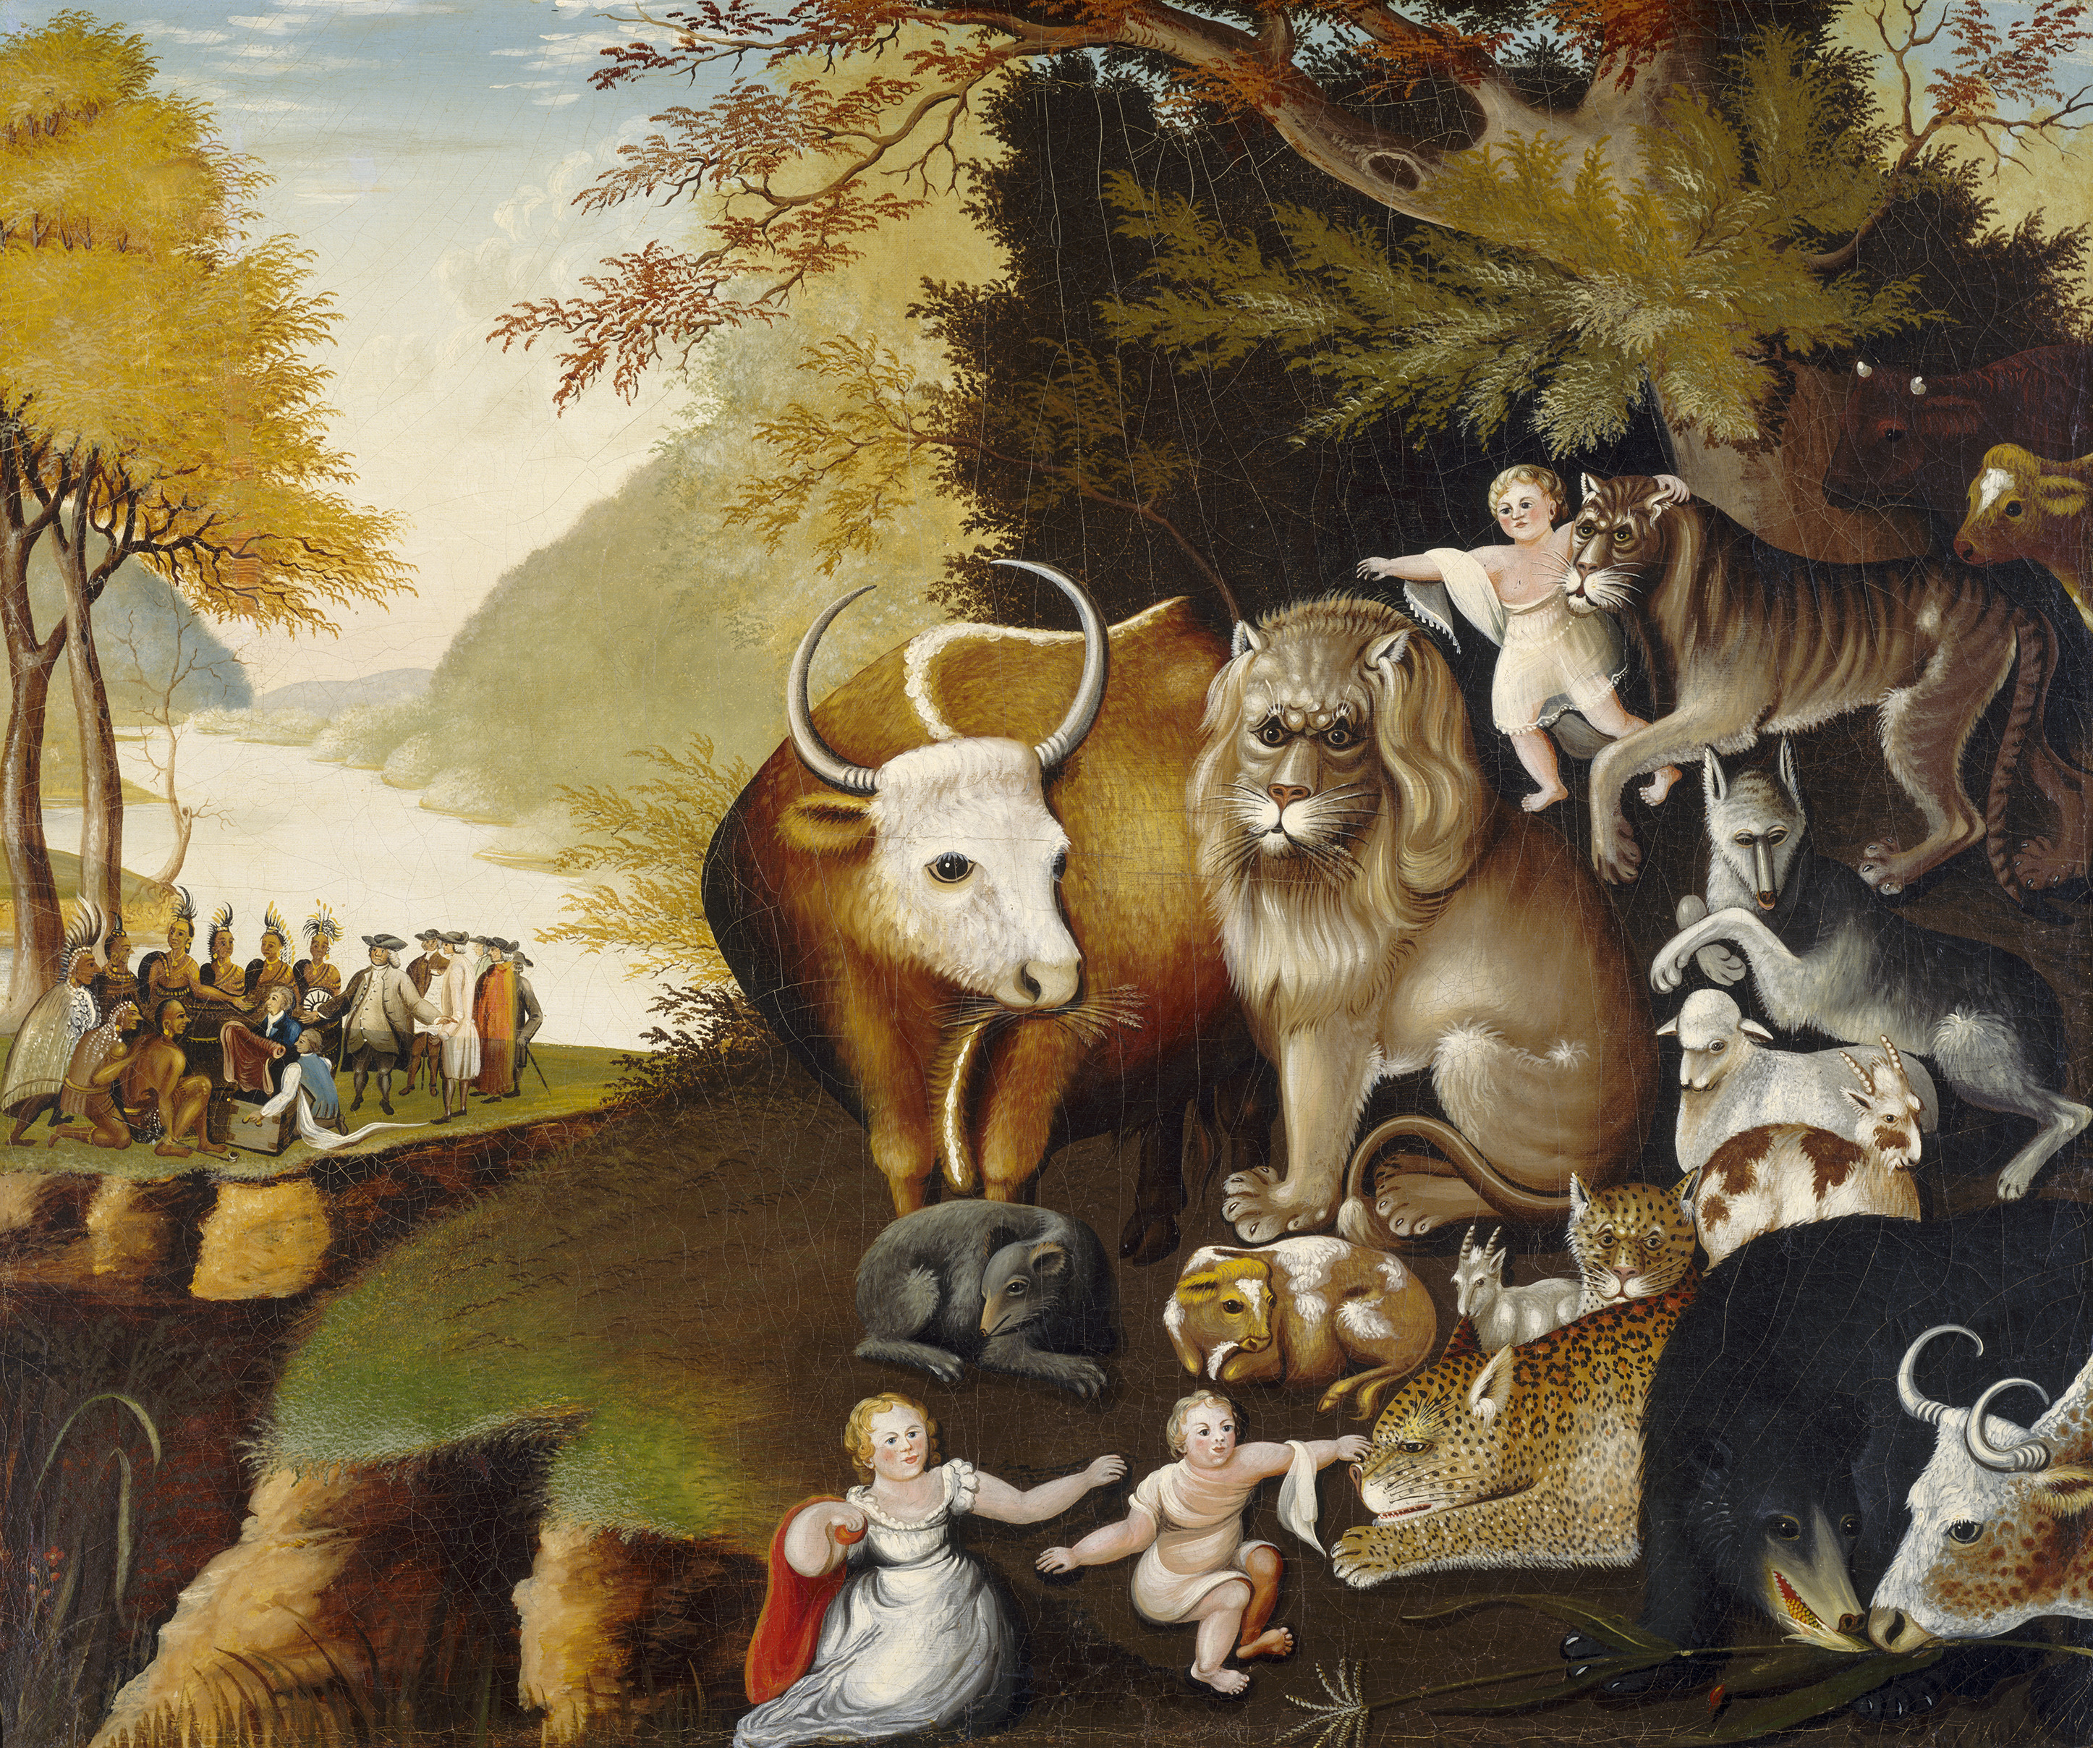
Floodlight/Flashlight

Slide 24
Floodlight/Flashlight
Toy
Store
Car
Flower
Chair
Hula hoop
Pharmacy
Police car
Violet
Recliner

Slide 25
Floodlight/Flashlight
The bat has many adaptations that help it survive.
The bat’s large ears with ridges and folds help it to hear a wide range of sounds.

Slide 26
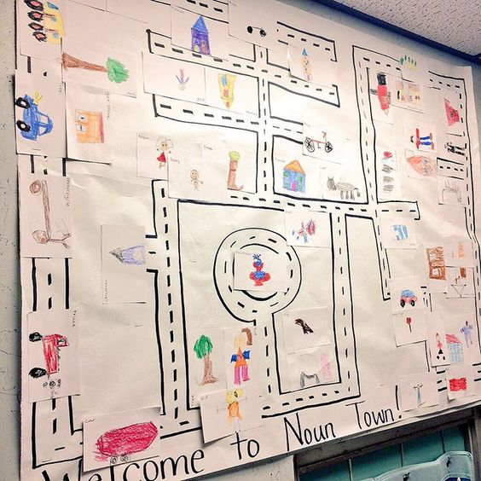
Noun Town and Verb Suburb

Slide 27
Specific Noun Word Bank
Entertainment | Occupations | Technology

Slide 28
The Lady Walked (Mundane Sentences)
The lady walked.

Slide 29
Sentence Slam
burped
laughed
jogged
bawled
wiggled
meditated
twirled
purred
boiled
hissed
disappeared
smiled
glittered

Slide 30
Relay Race

Slide 31
Verb Activities
Noun-Verb Stories
Graphic Organizer Sentences
Slap-Clap-Snap-Snap
I Have/Who Has
Notes:
From bulletin boards to activities to strengthen students’ knowledge and understanding of verbs
Different slide for each activity

Slide 32
Noun-Verb Stories
The snow fell. The wind blew. The drifts grew. The phone rang. “School Cancelled.” The students cheered.

Slide 33
Graphic Organizer Sentences
NOUN | VERB
The shortstop | tripped.
The quarterback | practiced.
The hippo | slumbered.
The butter | melted.
The detective | searched.
The magazine | ripped.
The hamburger | sizzled.

Slide 34
Slap-Clap-Snap-Snap

Slide 35
I Have/Who Has

Slide 36
Other Parts of Speech?
Adjectives
Adverbs
Prepositions
Notes:
Any of the activities you choose to use with your students should be done when teaching the patterns for that part of speech.

Slide 37
Adjective Activities
Adjective Avenue
Adjective Boxes
Extended Stories
Appetizing Adjectives
Degrees of Adjectives

Slide 38
Adjective Avenue

Slide 39
Adjective Boxes
A | N
B | O
C | P
D | Q
E | R
F | S
G | T
H | U
I | V
J | W
K | X
L | Y
M | Z

Slide 40
Extended Stories
The snow fell. The wind blew. The drifts grew. The phone rang. “School Cancelled.” The students cheered.

Slide 41
Extended Stories
The snow fell. The powerful wind blew. The icy drifts grew. The phone rang. “School Cancelled.” Joyous students cheered.

Slide 42
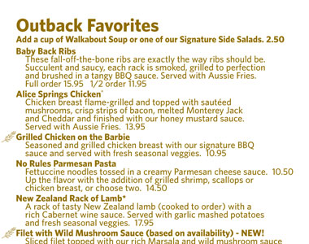
Appetizing Adjectives

Slide 43
Degrees of Adjectives
1. | bad | wicked | mischievous | evil | naughty
2. | little | tiny | petite | Itsy-bitsy | wee
3. | happy | joyous | content | ecstatic | elated
4. | sad | downcast | blue | miserable | crestfallen
5. | big | huge | gigantic | large | enormous

Slide 44
Adverb Activities
Adverb Alley
Question the Adverb
Brainstorm by Category
Brainstorm by Activity
Which is Stronger

Slide 45
Adverb Alley

Slide 46
Question the Adverb
Relocate
Adverb suffixes
Adverb questions

Slide 47
Brainstorm by Category
Manner How Something Is Done | Place Where Something Is Done | Time When Something Is Done | Frequency How Often Something Is Done
nosily | here | yesterday | daily
gently | indoors | today | regularly
quietly | home | suddenly | often

Slide 48
Brainstorm by Activity
Tell me how someone might…
Tell me where someone might…
Tell me when someone might…
Tell me how often someone might…

Slide 49
Which is Stronger?
The hikers ate the beef stew greedily.
The hikers wolfed down the beef stew.
The sprinter walked off the track painfully.
The sprinter hobbled off the track.

Slide 50
Preposition Activities
Preposition Park
Prepositional Plates
Sing the Prepositions
Fill In the Blanks
Penny Hunt
Preposition Flip Books
Extended Stories

Slide 51
Preposition Park

Slide 52
Prepositional Plates

Slide 53
Sing the Prepositions

Slide 54
Fill In the Blank
The picture ____________ my sister made me laugh.
The UFO flew ____________ the clouds.
The shed _____________ the street burned down.

Slide 55
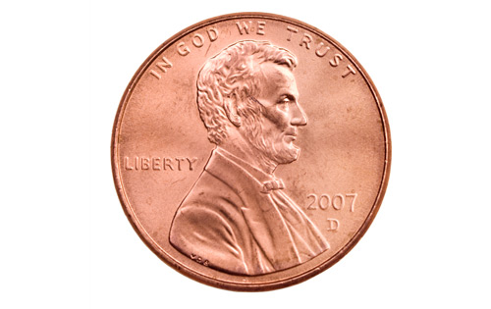
Penny Hunt

Slide 56
Preposition Flip Books
Sentences with prepositional phrases that function as adverbs.
Phrase | Noun | Verb | Noun
Sentences with prepositional phrases that function as adjectives.
Noun | Phrase | Verb | Noun

Slide 57
Extended Stories
The snow fell. The powerful wind blew. The icy drifts grew. The phone rang. “School Cancelled.” Joyous students cheered.

Slide 58
Extended Stories
The snow fell throughout the night. The powerful wind blew. The icy drifts grew into mountains. The phone rang. “School Cancelled.” Throughout the town joyous students cheered.

Slide 59
Steps for Teaching the Sentence Patterns
Read the title and sentences aloud (T)
Students work in small groups of three to write observations
Teacher-led whole class discussion of observations
Small group writing
Individual writing
Graded sentences into binder
Notes:
Handout: Guidelines for Writing Sentence Patterns
Explain and walk through the process of teaching the SP by using Open w/ Adverb

Slide 60
Step 1: Teacher reads
During the basketball game, our center sprained her ankle.
After lunch, my dad likes to take a long nap.
My brother returned his books to the library.
The school cancelled our picnic because of the tornado warning.
The restaurant served clam chowder instead of tomato bisque.
Read title and five sentences aloud
Use rhythm and intonation
Deal with any vocabulary issues
2-3 minutes

Slide 61
Step 2: Students Observe
During the basketball game, our center sprained her ankle.
After lunch, my dad likes to take a long nap.
My brother returned his books to the library.
The school cancelled our picnic because of the tornado warning.
The restaurant served clam chowder instead of tomato bisque.
Students in teams of three
List observations
commonalities
punctuation patterns
italicized part of sentence
5 minutes
Notes:
If you feel like they are struggling with their observations or may not totally understand, please feel free to write a few sentences together as a class—both examples and non-examples are useful here

Slide 62
Step 3: Whole-Class Discussion
During the basketball game, our center sprained her ankle.
After lunch, my dad likes to take a long nap.
My brother returned his books to the library.
The school cancelled our picnic because of the tornado warning.
The restaurant served clam chowder instead of tomato bisque.
Teams provide one observation
List these observations
Provide instruction on any missed elements
5-7 minutes

Slide 63
Step 4: Group Writing
Teams of three
ALL members of the team work on EACH sentence
ALL write the same five sentences
Members need to check each other’s work
Only SPECIFIC NOUNS and VIVID VERBS allowed
Only “famous” proper nouns are acceptable
Teacher checks each sentence before team is allowed to disband and move on to individual sentences (assignment)
Rest of the class period

Slide 64
Step 5: Individual Writing
Students work independently writing five sentences that follow the pattern.
Teacher continues circulating, checking sentences.

Slide 65
Step 6: File in Binder
Graded papers are returned to the students.
Returned papers are filed in order in their binders.
These completed, returned papers become their “textbooks”.

Slide 66
Practice
The Nile, the longest river in the world, flows from Lake Victoria to the Mediterranean Sea.
The Nile enters the Mediterranean Sea by a delta in Egypt, a country in northeastern Africa.
Scholars could decipher hieroglyphics after discovering the Rosetta Stone, a black basalt slab found in 1799.
The Sumerians invented cuneiform, a style of writing using wedge-shaped strokes.
The pyramids of Egypt served as tombs for the pharaohs, the rulers of ancient Egypt.
Notes:
Try another pattern together

Slide 67
List of Patterns
(3-8) #1: Specific Noun-Vivid Verb
(3-8) #2: Noun-Verb-Noun
(3-8) #3:Interrogative Sentence
(3-8) #4: Open with an Adverb
(3-8) #5: Open with a Prepositional Phrase
(3-8) #6: Compound Sentence w/ CC
(3-8) #7: Appositive Behind a Noun
(3-8) #8: Open with an Adverb Clause
http://www.phylsquill.com/downloads.htm
Notes:
Give notes specific to each pattern

Slide 68
(3-8) #9: Close with an Adverb Clause
(3-8) #10: Parallel Items in a Series
(3-8) #11: Parallel Verbs in a Series
(3-8) #12: Open with an Adjective
(3-8) #13: Open with a Present Participle
(4-8) #14: Open with a Past Participle
(6-8) #15: Open with a Present Perfect Part.
(6-8) #16: Open with an Infinitive Phrase

Slide 69
(6-8) #17: Restrictive Adjective Clause
(6-8) #18: Nonrestrictive Adjective Clause
(6-8) #19: Compound Sentence with a Semicolon
(7-8) #20: Compound Sentence with an Elliptical Expression
(7-8) #21: Opening with an Absolute
(7-8) #22: Adjectives Moved behind a Noun
(7-8) #23: Open with a Parallel Structure
(7-8) #24: Compound Sentence with a Conjunctive Adverb

Slide 70
Notes About the Sentence Patterns
Not all patterns are “typical”
Patterns in the book and on the website are a bit different

Slide 71
Combining Sentences
Understanding the relationship between ideas: time, condition, cause and effect, etc.
Selecting an appropriate conjunction to reflect the relationship
Changing nouns to pronouns appropriate in case and number
Embedding modifiers in appropriate locations
Manipulating verb forms to create participles and infinitives
Manipulating verb forms to show an accurate tense
Notes:
Skills students will develop through combing sentences

Slide 72
Practice (Part 1)
Using an Appositive (cued)
The cheetah sprints at sixty miles an hour.
The cheetah is an African cat.
Combination:
The cheetah, an African cat, sprints at sixty miles an hour.

Slide 73
Practice
Using an Appositive
My puppy snuggled on my lap.
My puppy is named Scamp.
Combination:
My puppy, Scamp, snuggled on my lap.

Slide 74
Practice
Using an Appositive
Spies and smugglers used buttons to hide things.
The things they hid were secret messages and poison.
Combination:
Spies and smugglers used buttons to hide things, secret messages and poison.

Slide 75
Practice
Open with an Adverb Clause (cued)
(when) Young bears play.
They bite each other on the neck.
Combination:
When young bears play, they bite each other on the neck.

Slide 76
Practice
Open with an Adverb Clause (cued)
(as) For centuries, people traveled.
They took their games to new places.
Combination:
For centuries, as people traveled, they took their games to new places.

Slide 77
Practice
Open with an Adverb Clause
The Seminoles began living in concrete housing.
The Seminoles still constructed thatched chickees for the summer.
Combination:
Even after the Seminoles began living in concrete housing, they still constructed thatched chickees for the summer.

Slide 78
Practice (Part 2)
The dolphin leaped.
The dolphin was gray.
The dolphin was in the aquarium.
The dolphin leaped through a hoop.
The hoop was plastic.
The dolphin leaped gracefully.
Notes:
Cross out repetition

Slide 79
Practice
The dolphin leaped.
The dolphin was gray.
The dolphin was in the aquarium.
The dolphin leaped through a hoop.
The hoop was plastic.
The dolphin leaped gracefully.
Notes:
Cross out repetition

Slide 80
Combination:
The gray dolphin in the aquarium leaped gracefully through a plastic hoop.

Slide 81
Combination:
In the aquarium, the gray dolphin leaped through a plastic hoop gracefully.

Slide 82
Combination:
Gracefully, the gray dolphin in the aquarium leaped through a plastic hoop.

Slide 83
Practice (Part 3)
Grace hurried.
She did that in the morning.
She had to mail the letter.
She would do that before going to school.
She kept it hidden.
It was under her cape.
She had written to Mr. Lincoln.
Levant would laugh.
He would do that if he knew about the letter.
Notes:
Most difficult! Sentences are not grouped together in sets. Students must determine which sentences go together and how to connect them to create sentences in a paragraph.

Slide 84
Original text from Mr. Lincoln’s Whiskers (Winnick, 1996, p. 12):
In the morning, Grace hurried to mail the letter before going to school. She kept it hidden under her cape. If Levant knew she had written to Mr. Lincoln, he would laugh.

Slide 85
EXTRA Practice Possibilities
Marker Boards
Picture Walks
Sentence Expansion
Color-Coded Sentences

Slide 86
Marker Boards
Number off by 3s
All students on the team write the exact same sentence, checking each other’s work
Teacher tells what pattern to write, including a word to use
Students may use their binders
Points awarded for PERFECT sentences

Slide 87
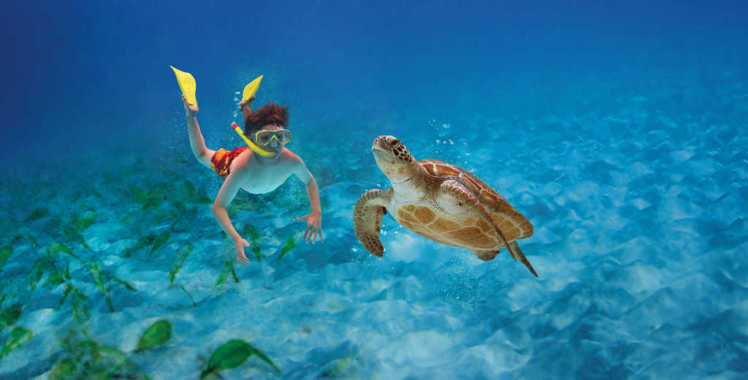
Picture Walk
Target Sentence: The diver, a young boy, swam toward the sea turtle.

Slide 88
Sentence Expansion
Embed the Following | New Sentence
 | The squirrel scampered.
Prepositional Phrase | In the morning, the squirrel scampered.
Adjective | In the morning, the brown squirrel scampered.
Adverb | In the morning, the brown squirrel scampered playfully.
Revise | In the morning, the brown squirrel scampered

Slide 89
Color-Coded Sentences

Slide 90
Short Writing Assignments (Opening Activities)
Personal Descriptions
Write-Embed-Revise
Floodlight/Flashlight
Help Me Visualize

Slide 91
Personal Descriptions
Guitar Book Soda Refrigerator Microwave Flowers Printer | Garmin Brussel sprouts Running shoe Treadmill Computer Juice Eye glasses | Magazines Rap music Poetry Thumbtack Cell phone Remote control car Pencil

Slide 92
Write-Embed-Revise
The squirrel climbed up the tree.
The frisky, furry, bushy-tailed brown squirrel climbed quickly to the top of the towering old oak tree loaded with acorns in the neighbor’s yard.
In search of acorns, the squirrel scampered to the top of my neighbor’s tree.

Slide 93
Floodlight-Flashlight Sentences
Floodlight | Flashlight | Sentence
Character | Spongebob | Spongebob, who lives in a pineapple under the sea, fries crabby patties at the Krusty Krab.
Car | Mustang | When my old car died, I bought a new Mustang.
Flower | rose | Each bridesmaid carried a single yellow rose, the state flower of Texas.
Book | The Lightning Thief | The student enjoyed The Lightning Thief movie until he read the book.
Artist | Picasso | Chicago features several sculptures by the artist Picasso.
Scientist | Einstein | Many people consider Einstein the greatest scientist of all time.

Slide 94
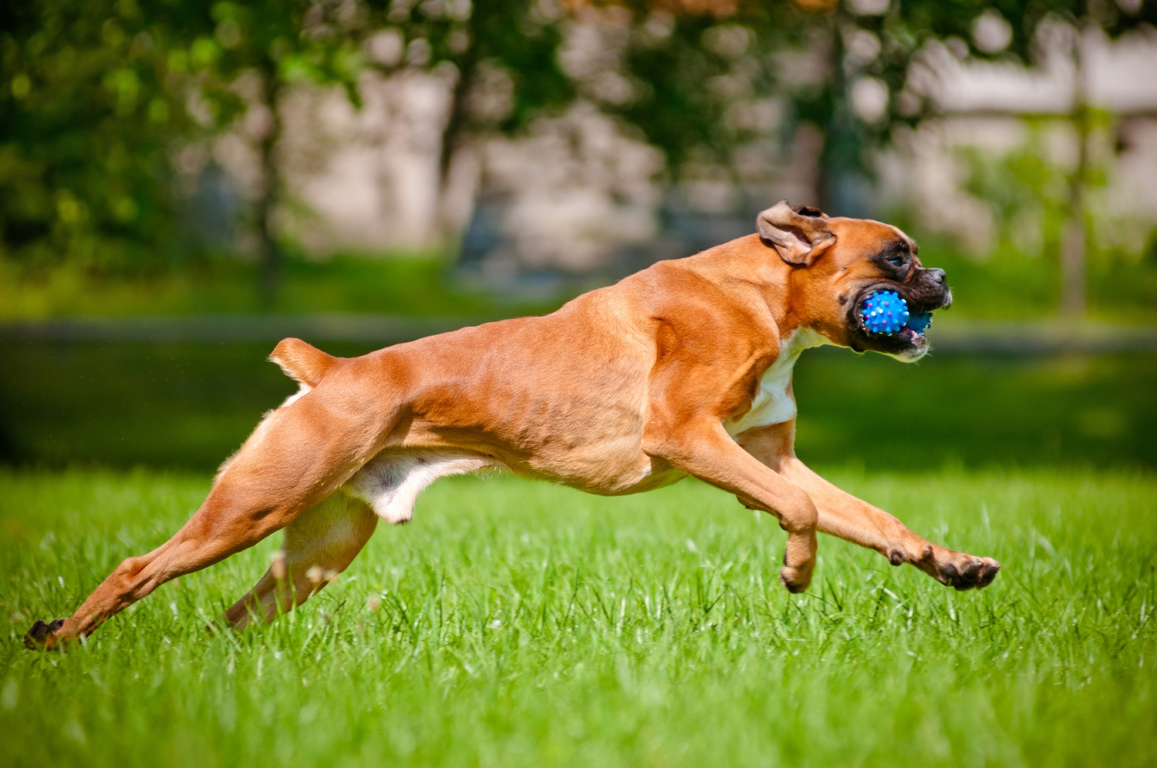
Help Me Visualize
Students simply write a sentence about the picture that uses a specific noun and vivid verb.

Slide 95
Short Writing Assignments (Targeted Activities)
Literature in the Papers
Vocabulary People
Build a Sentence
Notes:
Coherence, cohesion, openings, and closings are dealt with in longer writing assignments

Slide 96
Sentence Construction Rubric
 | ☺ | 😐 | ☹
Specific Nouns
Vivid Verbs
Sentence Variety: Length and Pattern
4-10 Sentences
Powerful Conventions
 | A = 4-5 smiles/no frowns B = 3 smiles/no frowns C = 1 or 2 smiles/ no frowns

Slide 97
Literature in the Papers

Slide 98
Vocabulary People
Acerbic Acrimonious Laconic Legendary Parsimonious Pensive Placid Pugnacious Querulous Reticent Sagacious Sinister | Altruistic Demure Impertinent Indolent Insipid Intrepid Jocose Lethargic Loquacious Magnanimous Mendacious Meticulous | Apathetic Angelic Avaricious Bellicose Erudite Garrulous Incorrigible Ostentatious Sullen Taciturn Truculent Vivacious

Slide 99
Build a Sentence
when | desolate | ledge
cave | home | forest
picking | carrying | flew
march | roots | beneficial
admirable | leisure | gaze
noble | cowardly | selfish
appearance | morning | citizens
enthusiasm | truly | wonderful
Words taken from The Griffin and the Minor Cannon by Frank R. Stockton (1986).

Slide 100
From Patterns to Essays
Writing Workshop
Students-Created Rubrics
Graphic Organizers
Notes:
It is not necessary to teach all of the patterns before writing essays. Phyllis starts with expository (usually from topics just taught or being taught in other subjects), on to narrative, and then argumentative.
Starts by reading NUMEROUS examples of essays (appendix of CCSS)
20-30 essays in a range of quality
Re-type ,fixing all capitalization, usage, punctuation, and spelling errors and formatting them all the same so that students are focused on the focus, organization, etc.
Place on walls for a gallery walk so that students can mark each with a W (weak essay) or S (strong essay). May also color code them.
Separate essays into two groups: strong and weak
Discuss the characteristics/qualities of both piles
Create rubrics from these

Slide 101
Sample Expository Essay Rubric
This expository essay demonstrates the following characteristics:
FOCUS | 4 | 3 | 2 | 1
The opening attempts to spark interest | 4 | 3 | 2 | 1
The closing makes a point and gives a sense of ending | 4 | 3 | 2 | 1
It stays with the important points—all the sentences fit together | 4 | 3 | 2 | 1
SUPPORT
Specific nouns and vivid verbs make is sound like a human wrote it | 4 | 3 | 2 | 1
Enough details let readers see and hear—they can visualize | 4 | 3 | 2 | 1
ORGANIZATION
It has a variety of sentence patterns and lengths for cohesion | 4 | 3 | 2 | 1
It moves smoothly form one paragraph to the next (coherence) | 4 | 3 | 2 | 1
Transitions do not stick out like a red flag but show how ideas connect | 4 | 3 | 2 | 1
CONVENTIONS
Powerful conventions help the reader understand the ideas | 4 | 3 | 2 | 1
TOTAL POINTS

Slide 102
Graphic Organizers
Focus:
Floodlight: | Floodlight:
Flashlight: | Flashlight:

Slide 104
Contact Info
srubach@steeleville138.org
http://mrsrubach.weebly.com/sentence-patterns-workshop.html
Material taken from:
Hostmeyer, Phyllis. Tools Students Need to be Skillful Writers.
Thousand Oaks, CA: Corwin, 2013.

